Slide 1

Computer Graphics
CS C 471 and IS C 471
Dr. Lucy J. Gudino
Computer Science & Information Systems Group
Birla Institute of Technology & Science, Pilani, Goa Campus

Slide 2
Circle Drawing

Slide 3
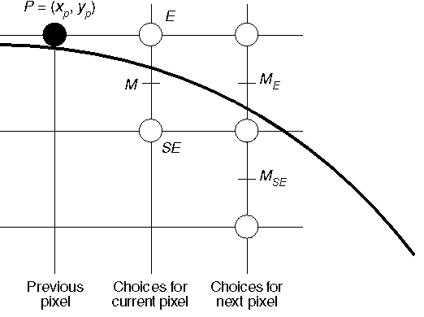
Contd...
Midpoint Circle Algorithm
  trace out arc in 2nd octant and draw the rest by symmetry
  choose between E and SE pixel at each stage

Slide 4
Contd…
Use of Symmetry: Only need to calculate one octant. One can get points in the other 7 octants as follows:
  Draw_circle(x, y)
  begin
    Plotpoint (x, y); Plotpoint (y, x);
    Plotpoint (x, -y); Plotpoint (-y, x);
    Plotpoint (-x, -y) ; Plotpoint (-y, -x);
    Plotpoint (-x, y); Plotpoint (-y, x);
  end

Slide 5
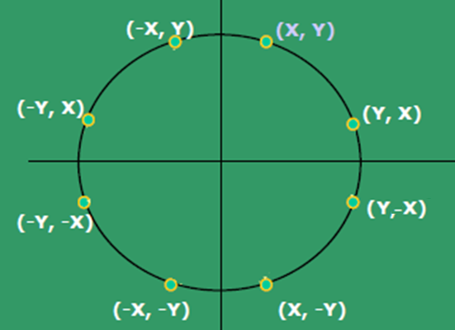
Contd…

Slide 6
The Midpoint Circle algorithm(version 1)
x = 0; y = R;
h = 1 – R;
draw_circle(x, y);
while (y > x)
  if (h < 0) /* select E */
    h = h + 2x + 3;
else /* select SE */
h = h + 2(x - y) + 5;
y = y - 1;
endif
x = x + 1;
draw_circle(x, y);
End_while

Slide 7
Analysis…
Requires at least 1 multiplication and 3 additions per pixel.
(Δd)_{E} and (Δd)_{SE} are linear functions and not constants.
Serious drawback!!

Slide 8
Solution
Version 2 algorithm
Instead of taking first order difference use second order difference : (Δd²)_{SE} and (Δd²)_{E}
earlier version
(Δd)_{SE} = d_{new} – d_{old}
        = F(Xp + 2, Yp - 3/2) - F(Xp + 1, Yp- 1/2)
        = 2Xp – 2Yp + 5 ;
(Δd)_{E} = d_{new} – d_{old}
        =F(Xp + 2, Yp - 1/2) - F(Xp + 1, Yp- 1/2)
        = 2Xp + 3;

Slide 9
Contd…
If the choice is E
  calculate (Δd²)_{E/E} and (Δd²)_{E/SE}
If the choice is SE
  calculate (Δd²)_{SE/E} and (Δd²)_{SE/SE}

Slide 10
The MidPoint Circle Algorithm
(Version 2)
x = 0; y = radius; h = 1 – R ;
deltaE = 3 ; deltaSE = -2*R + 5 ;
DrawCircle(x, y);
while (y > x)
if (h < 0) /* select E */
h = h + deltaE ;
deltaE = deltaE + 2;
deltaSE= deltaSE + 2

Slide 11
Contd..
else /* select SE */
h = h + deltaSE ;
deltaE = deltaE + 2 ;
deltaSE = deltaSE + 4
y = y – 1 ;
endif
x = x + 1 ;
DrawCircle(x, y) ;
End_while

Slide 12
Ellipses

Slide 13
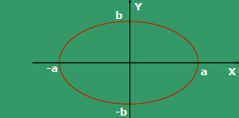
Introduction
Ellipse is an elongated circle
let a and b are semi major and minor axis
(x_{c},y_{c}) is the center of the ellipse
Equation of Ellipse centered at origin:
F(X,Y) = b²X² + a²Y² - a²b² = 0
Length of the major axis: 2a
and minor axis: 2b

Slide 14
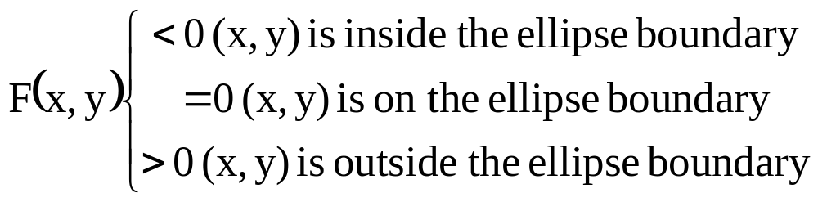
Introduction…

Slide 15
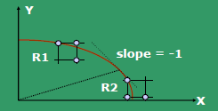
Contd…
Divide the quadrant into two regions R1 & R2
  The boundary between the two region is the point at which the curve has a slope of -1
  Draw pixels in two regions R1 and R2, to fill up the first Quadrant.
  Points in other quadrants are obtained using symmetry.
Notes:
The choice of pixels R1: E and SE
R2: S and SE

Slide 16
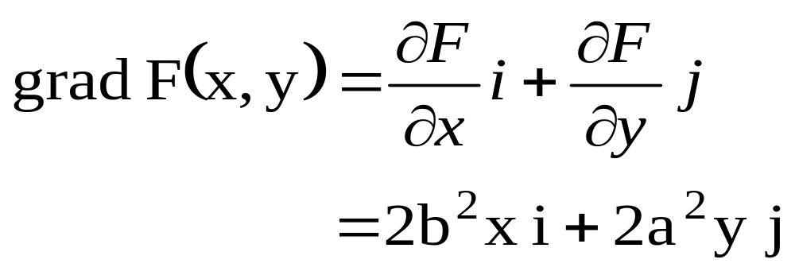
Contd…
How to obtain the point where the slope of the curve is -1?
The vector that is perpendicular to the tangent to the curve at point P is called gradient and is defined as
Notes:
I and j are unit vectors wrt x and y

Slide 17
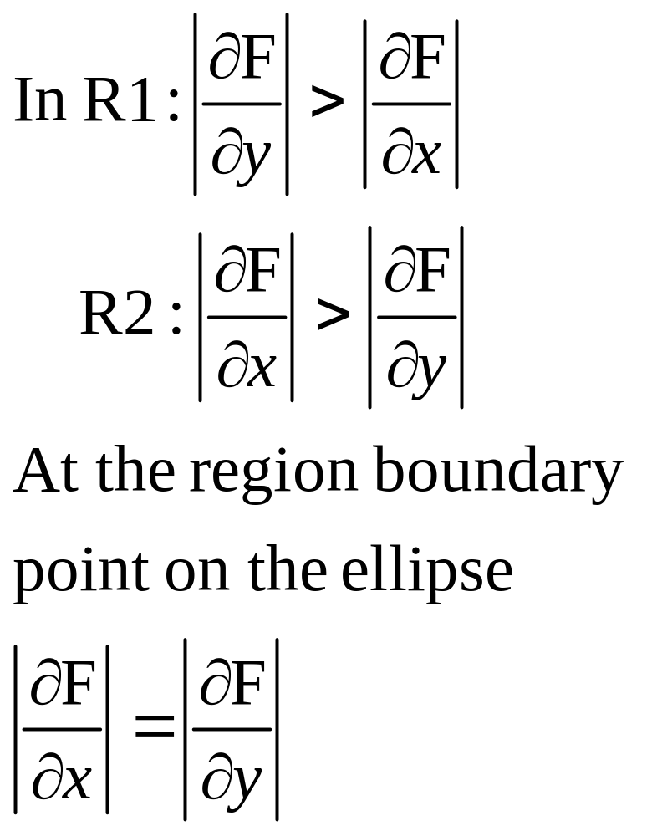
Contd…
The choice of pixels in R1 is between E and SE, whereas in R2, it is S and SE.

Slide 18
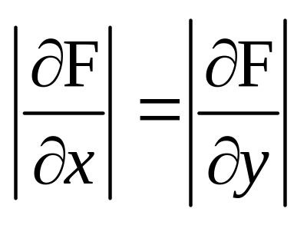
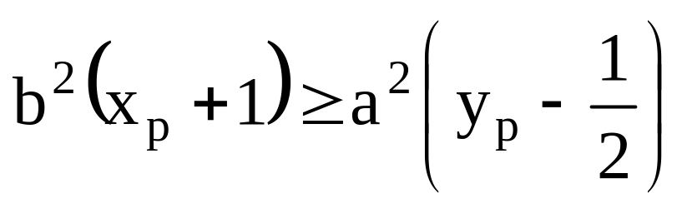
Contd…
Based on the condition we obtain the criteria when the next mid-point moves from R1 to R2:
When the above condition occurs, switch from R1 to R2

Slide 19
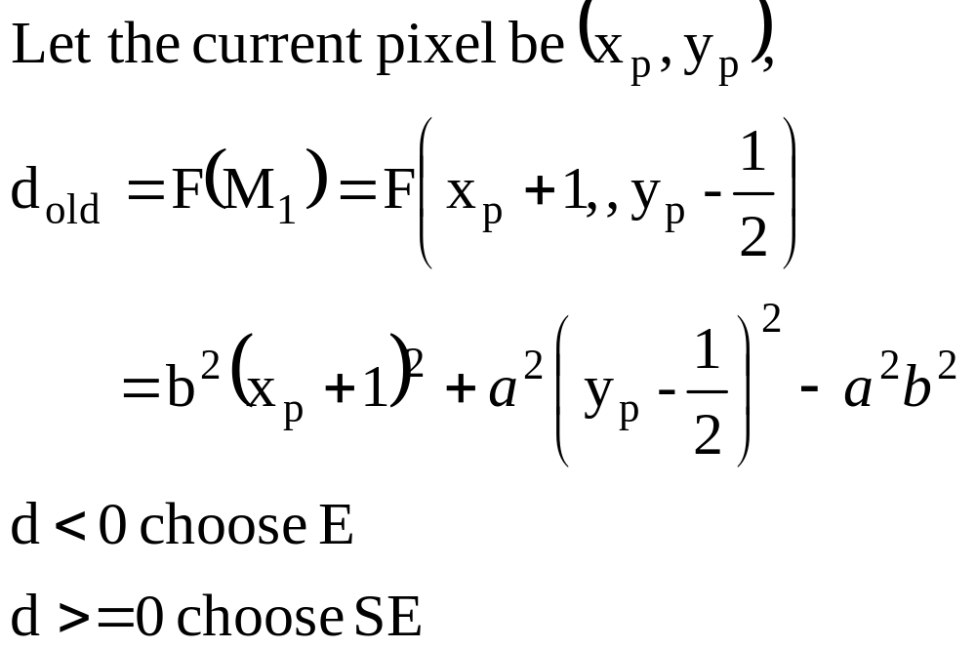
Analysis in region R1

Slide 20
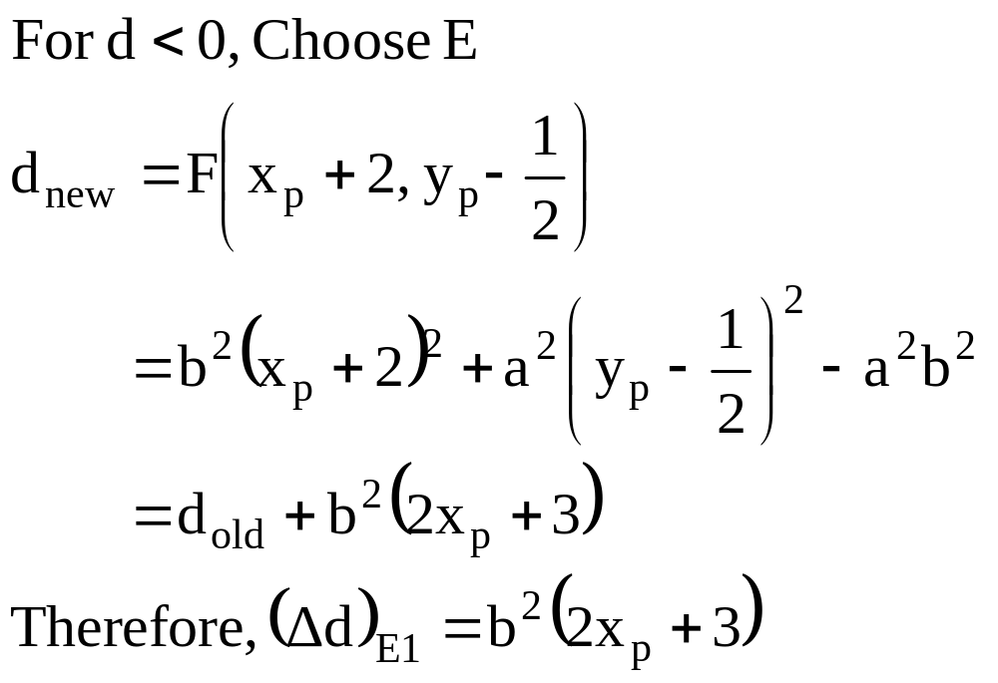
Contd…

Slide 21
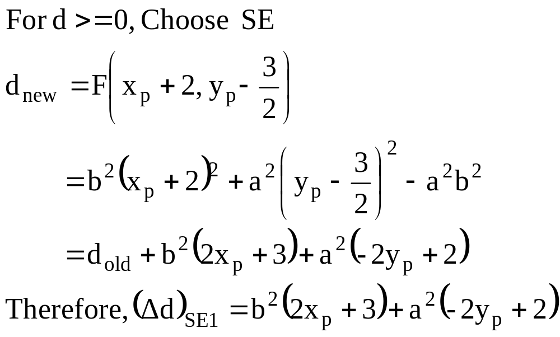
Contd

Slide 22
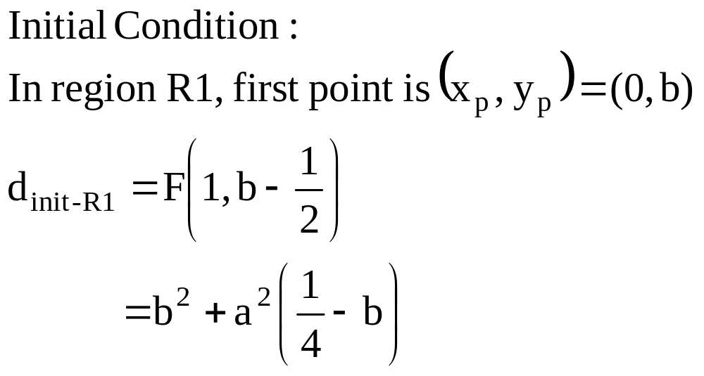
Contd..

Slide 23
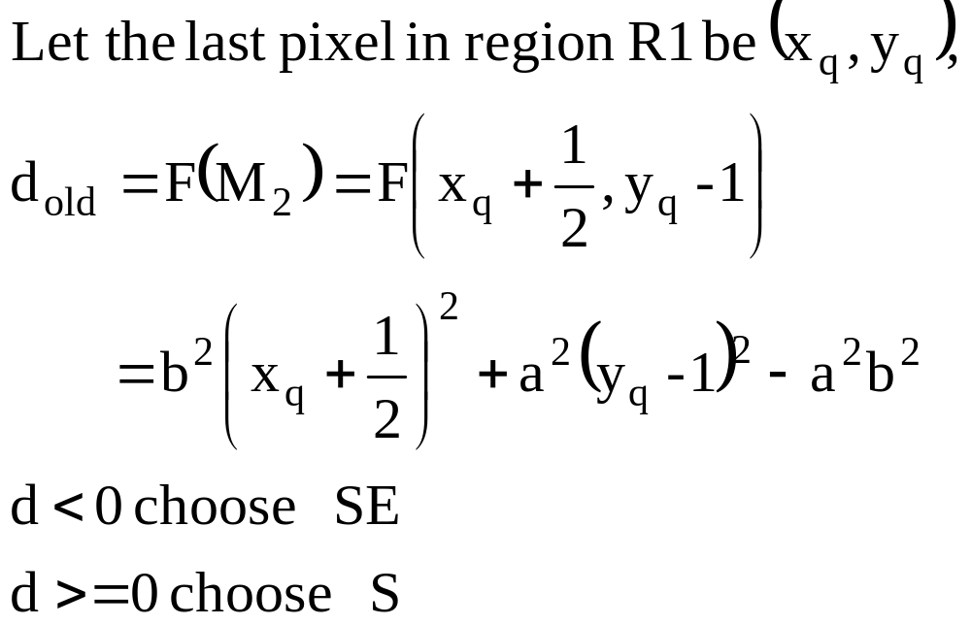
Analysis in region R2
Switch to R2 when

Slide 24
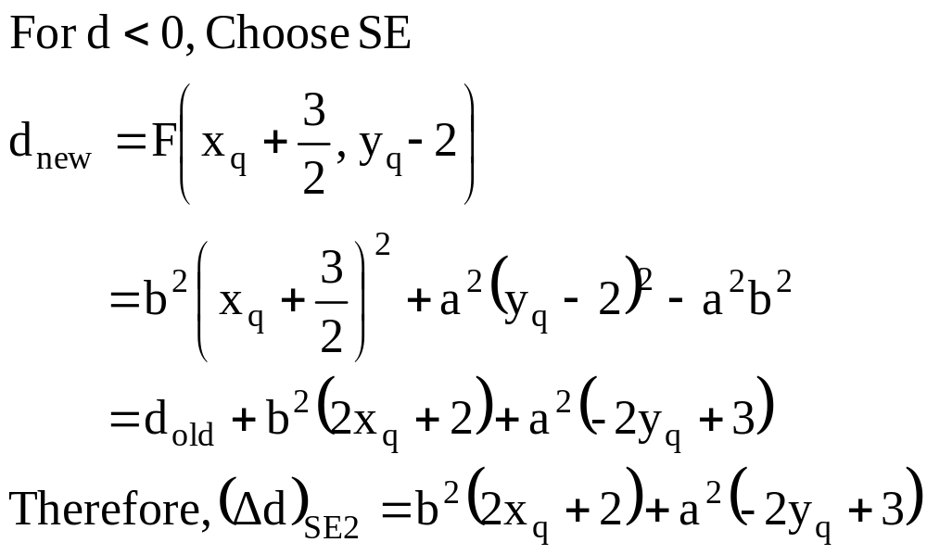
Contd…

Slide 25
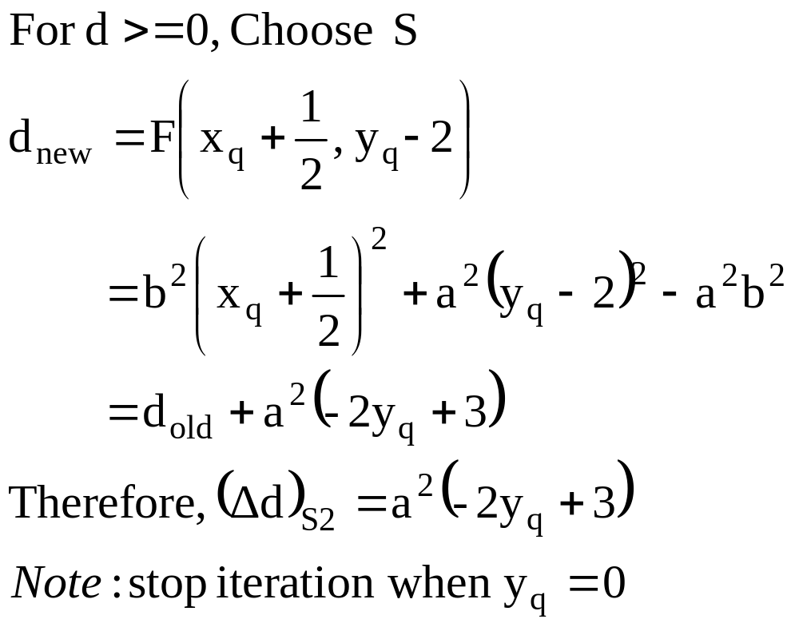
Contd…

Slide 26
void MidPointEllipse (int a, int b, int value){
double d2; int X = 0; int Y = b;
sa = sqr(a); sb = sqr(b);
double d1 = sb – sa*b + 0.25*sa;
EllipsePoints(X, Y, value); /* 4-way symmetrical pixel plotting */
while ( sa*(Y - 0.5) > sb*(X + 1)) /*Region R1 */
{ if (d1 < 0) /*Select E */
d1 += sb*((X<<1) + 3);
else /*Select SE */
{ d1 += sb*((X<<1) + 3) + sa*
(-(Y<<1) + 2); Y-- ;
}
X++ ; EllipsePoints(X, Y, value);
}

Slide 27
double d2 = sb*sqr(X + 0.5) + sa*sqr(Y - 1) - sa*sb;
while ( Y > 0) /*Region R2 */
{
if (d2 < 0) /*Select SE */
{
d2 += sb*((X<<1) + 2) + sa*(-(Y<<1) + 3);
X++;
}
else /*Select S */
d2 += sa*(-(Y<<1) + 3);
Y-- ;
EllipsePoints(X, Y, value);
}
}

Slide 28
Example
Draw ellipse with parameter
a = 6 and b = 4

